Slide 1


Slide 2

Team Members
1.Raksha Agrawal (0103IS231147)
2.Deepak Avachitkar (0176CD231054)
3.Akansha Shukla (0176CD231019)
4.Anushri Tiwari (0157CY231023)

Slide 3


Slide 4


Slide 5


Slide 6


Slide 7


Slide 8


Slide 9


Slide 10


Slide 11
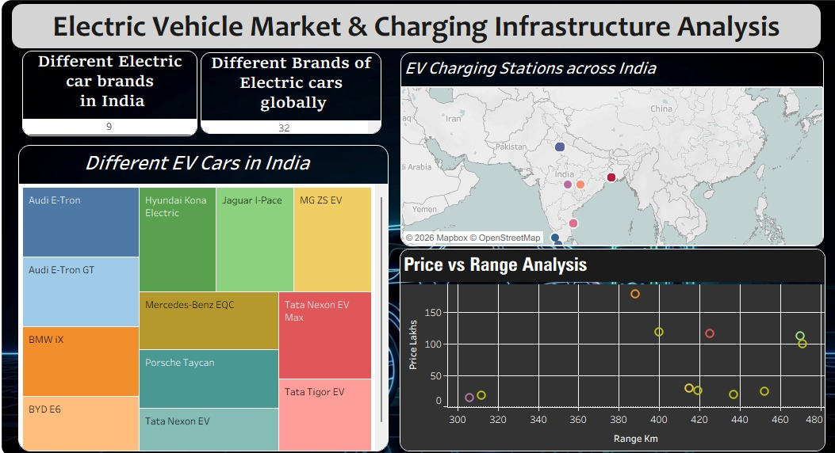

Slide 12


Slide 13


Slide 14


Slide 15


Thank You

